Slide 1
COMPUTERIZED SYNOPSIS GENERATOR
Team : -
Sweta Gupta - 28
Yash Jobalia - 30
Isheet Shetty - 55
Project Guide: Prof. Anagha Patil

Slide 2



Team Members
Sweta Gupta 61
Yash Jobalia 63
Isheet Shetty 72

Slide 3
Introduction
When we generally open news sites, we do not read every news article. We typically glance at the short news summary and then read more details if interested. Similarly, when we read a long paragraph, we generally list down the important points or important phrases in our minds, they are a form of short summaries of the passage. As we can see that summarization is an important aspect in our day to day lives, it saves our time and efforts. Now imagine what if these short summaries were generated automatically for you for the given texts. Reducing the number of text or generating short summaries with a computer program that retains the most important points of the original text would be a great tool to come in handy.

Slide 4
Motivation
In today’s world, time is precious and equivalent to money, so no one has the time to read long reports.
Hence our summarizer helps us to save that precious time by creating short summaries of long texts and chapters .
Our project can summarize audios and text into short summaries in order to give brief ideas of the important topics.

Slide 5
Problem Statement
Today, our world is parachuted by the gathering and dissemination of huge amount of data. With such a big amount of data circulating in the digital space, there is a need to develop machine learning algorithms that can automatically shorten longer texts and deliver accurate summaries that can fluently pass the intended messages. So, an automated summary is an effective way to solve this problem. Hence, to produce summary without any human help while preserving the meaning of the original text document, we can use a ML model with bi-directional RNN with LSTM in encoding and attention model in decoding layer by applying Sequence-To-Sequence model .

Slide 6
Literature Review
6

Slide 7
Analyzing Fuzzy Based Approach for Extractive Text Summarization
Abstractive Method of Text Summarization with Sequence to Sequence RNN ’s
Extractive Text Summarization using Sentence Ranking
1
3
5
2
4
Extractive Text Summarization by Feature-Based Sentence Extraction using Rule-Based concept
NLP based Latent Semantic Analysis for Legal Text Summarization

Slide 8
Extractive Text Summarization using Sentence Ranking
Dataset : 5 documents with 20 sentences
Moto : Summarize documents using Extractive Text Summarization.
Approach : Extractive Text Summarization using Sentence Ranking [1]
Implementation :
Firstly, the file which is given as input is tokenized.
The stop words are removed from the text.
The words which are remained are considered as a keyword.
After completing this preprocessing step we are calculating frequency.
Now weighted frequency of the word is calculated.
Finally, summarizer will extract the high weighted frequency sentences and the extracted sentences are converted into audio form.
DRAWBACK : Accuracy level is low.
FUTURE SCOPE : Multiple documents of similar topic can also be summarized.
Notes:
***** SENTENCE RANKING *****
Dataset : 5 documents with 20 sentences
Moto : Summarize documents using Extractive Text Summarization.
Approach : Extractive Text Summarization using Sentence Ranking
Implementation : They are taking input as text file (.txt). Firstly, the file which is given as input is tokenized in order to get tokens of the terms. The stop words are removed from the text after tokenization. The words which are remained are considered as a keyword. The key words are taken as an input for that we are attaching a part of tag to each keyword. After completing this pre-processing step, we are calculating frequency of each keyword like how frequently that key word has occurred, from this maximum frequency of the keyword is taken. Now weighted frequency of the word is calculated by dividing frequency of the keywords by maximum frequency of the key words. In this step they are calculating the sum of weighted frequencies. Finally, summarizer will extract the high weighted frequency sentences and the extracted sentences are converted into audio form.
Drawback : Accuracy level is low.
Future Scope : Multiple documents of similar topic can also be summarized.
After completing the pre-processing step we calculate frequency of each keyword like how frequently that key word has occurred, from that maximum frequency of the keyword is taken. Then weighted frequency of the word is calculated by dividing frequency of the keywords by maximum frequency of the key words. In this step, we calculate the sum of weighted frequencies. Finally, summarizer will extract the high weighted frequency sentences and the extracted sentences are converted into audio form.

Slide 9
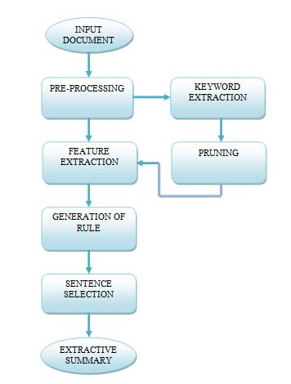
Extractive Text Summarization by Feature-Based Sentence Extraction Using Rule-Based Concept
Dataset : Document Understanding Conferences (DUC) 2002 dataset.
Work : Summarize documents using Extractive Text Summarization.
Approach : Extractive Text Summarization using Rule-Based Summarizer [2]
Implementation :
Pre-processing is the most primary step.
Then, the next step is keyword extraction.
Then comes the pruning, a threshold is defined.
Once threshold is calculated, all terms with tf less than the threshold value are pruned off from the document.
Seven features are calculated for each sentence and each feature is given a value from 0 to 1 after normalization.
All sentences are sorted in ascending order based on their scores. Final extractive summary of the document will be displayed.
DRAWBACK : Accuracy level is low.
FUTURE SCOPE : Multiple documents of similar topic can also be summarized.
Notes:
***** Rule-Based Concept *****
Dataset : Document Understanding Conferences (DUC) 2002 dataset
Moto : Summarize documents using Extractive Text Summarization.
Approach : Extractive Text Summarization using Rule-Based Summarizer
Implementation : The main focus of this paper is to summarize a single document and create its extractive summary. Pre-processing is the most primary step in any summarization method. Pre-processing methods applied are tokenization, stop word removal and stemming. Then, the next step is keyword extraction. In keyword extraction phase, frequency count of each word or a term in a document is calculated in order to find out its importance. Then, in pruning, a threshold is defined. This value is calculated, by summing the term with lowest frequency and the term with the largest frequency thus taking their mean. Once threshold is calculated, all terms with tf less than the threshold value are pruned off from the document. After pre-processing step, each sentence of document is represented as attribute vector of features. Seven features are calculated for each sentence and each feature is given a value from 0 to 1 after normalization. Features considered are Sentence Position, Title Feature, Numerical Value, Keyword Weight, Proper Noun, Sentence To Sentence Similarity, Sentence Length. All sentences are sorted in ascending order based on their scores. Final extractive summary of the document will be displayed.
Drawback : Accuracy level is low.
Future Scope : Multiple documents of similar topic can also be summarized.

Slide 10
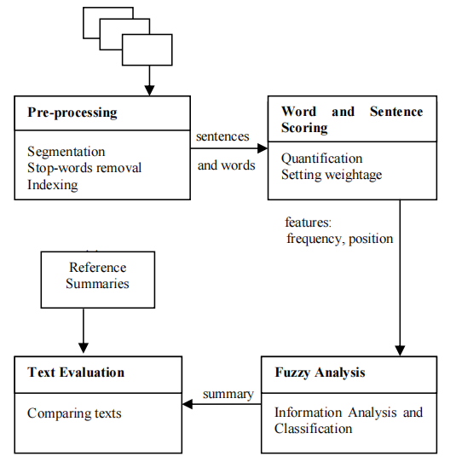
Gensim for Extractive Text Summarization
Dataset : BBC news summary dataset.
Work : summarise news reports using fuzzy logic.
Approach : extractive text summarisation using fuzzy logic and triangular method [3]
Implementation :
First the data set is pre processed.
Then calculate frequency and position this is done by using hashmap.
The last step is fuzzy analysis where the calculated values are used to find the mean for that sentence and are fed to the triangular membership function which give values between 0 and 1 to each sentence and the fuzzy rule is applied.
Finally they ROUGE score is given to each and every summary to be compared efficiently.
DRAWBACK :There is no criteria where all the 3 recall precision and f member are greater than using bell membership function .
FUTURE SCOPE : The value of these can be enhanced more by using abstractive method.

Slide 11
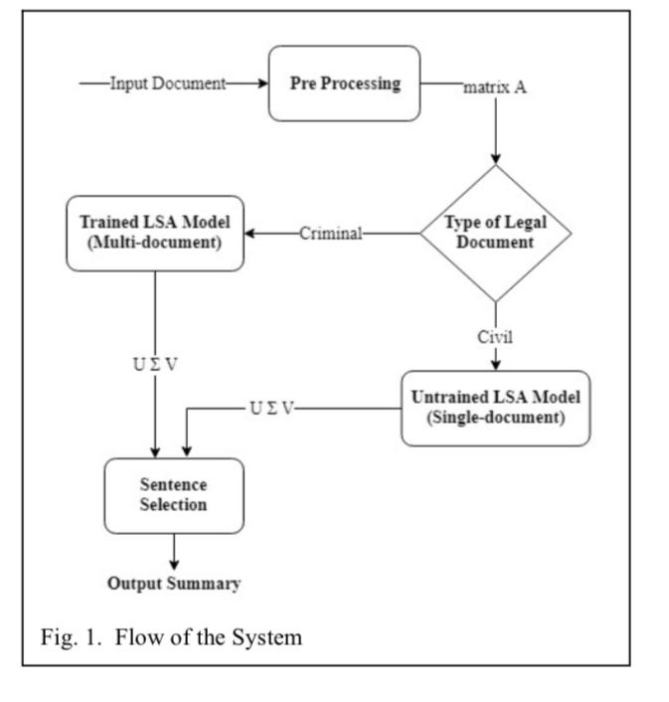
NLP based Latent Semantic Analysis for Legal Text Summarization
Dataset : They used data set from supreme high and district court cases
Work : summarise legal documents and judgements passed in courts
Approach : Latent semantic analysis i.e creating short summaries on basis of similar words [4]
Implementation :
They use 2 approaches depending on the type of case if it is a criminal case single document untrained approach is used and for civil case multi-document trained approach is used.
Firstly pre-process the data.
Then passing it through the model depending on the type finally judgement passed and then final summary output is generated.
DRAWBACK : Extractive and not completely effective.
FUTURE SCOPE : Aims to improve summary generated not only on the basis of similar words but also similar concepts.

Slide 12
Comparative Study
Paper | [1] | [2] | [3] | [4] | [5]
Types Of Summarization | Extractive Summarization | Extractive Summarization | Extractive Summarization | Extractive Summarization | Abstractive Summarization
Method Used | Sentence Rating Method | Gensim | Rule-Based Method | Semantic Analysis | Pegasus
Training Model | Sentence Ranking with Text Rank | Graph based summarizer | Rule-Based Summarizer | Single Document Untrained Approach For Criminal Multi Document Trained Approach For Civil | Xsum, Xlarge, reddit-tifu model
Dataset | 5 Documents with 20 sentences | Bag of words | DUC 2002 | District, High and Supreme Court | Amazon Fine Food Review
Accuracy | Low | Low | Low | Low | High

Slide 13
Project Implementation Flow
Input
User can select any one of the methods for input: Audio or Document
Using Python Speech Recognition/ Google Speech To Text API
Document
Text Extraction
Audio
Text
Additional Feature
Further summary can be converted to speech
Summarized Text
15

Slide 14
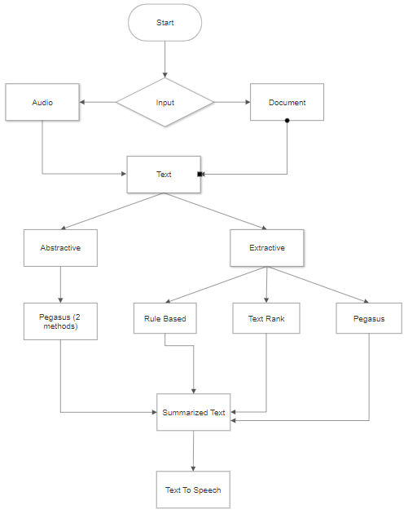
Flowchart
15

Slide 15
Implementation

Slide 16
Overview
The entire project is divided into three phases:
Speech To Text Phase: The first phase aims at converting the audio files into texts.
Text Summarization Phase: It deals with the summarization of the text which were the output from the previous phase.
Text To Speech Phase: This phase has the main purpose of converting the summarized text outputs into audio form.
15

Slide 17
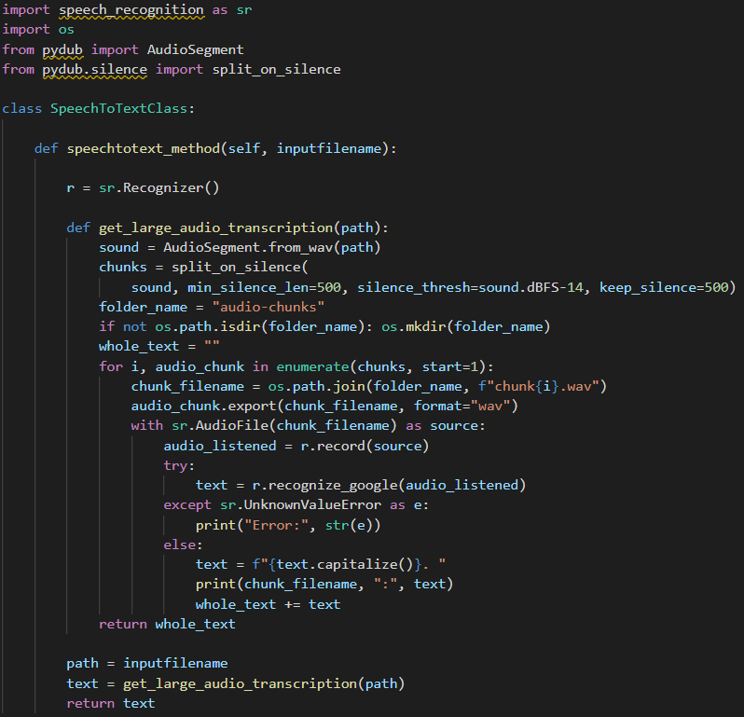
Speech To Text

Slide 18
Methods Implemented
Xsum(A), large(E), Reddit tifu(A)
Gensim Approach
Depends on User Input(E)
Depends on User Input(E)
Transformer Model Approach (Pegasus)
Rule Based Approach

Slide 19
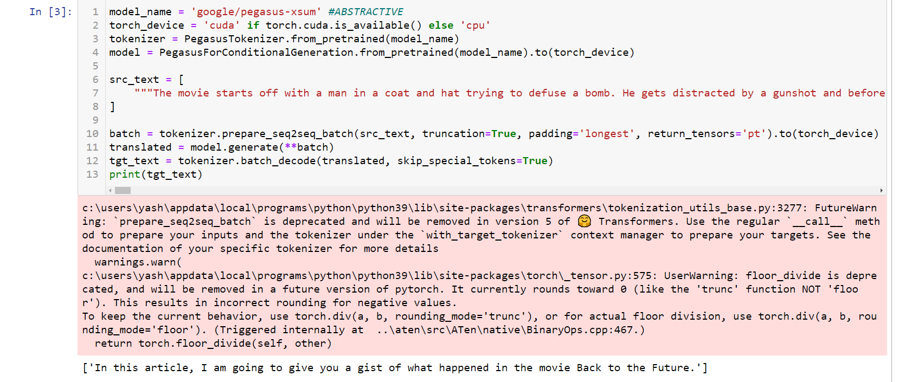
Pegasus (xsum)_Abstractive This model gives very short abstractive summary of the text passage.

Slide 20
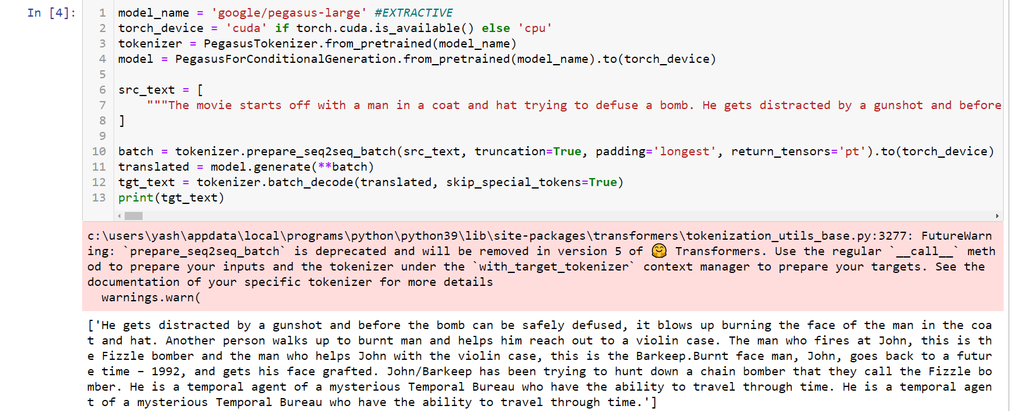
Pegasus (Large)_Extractive
This model gives brief abstractive summary of the text passage.

Slide 21
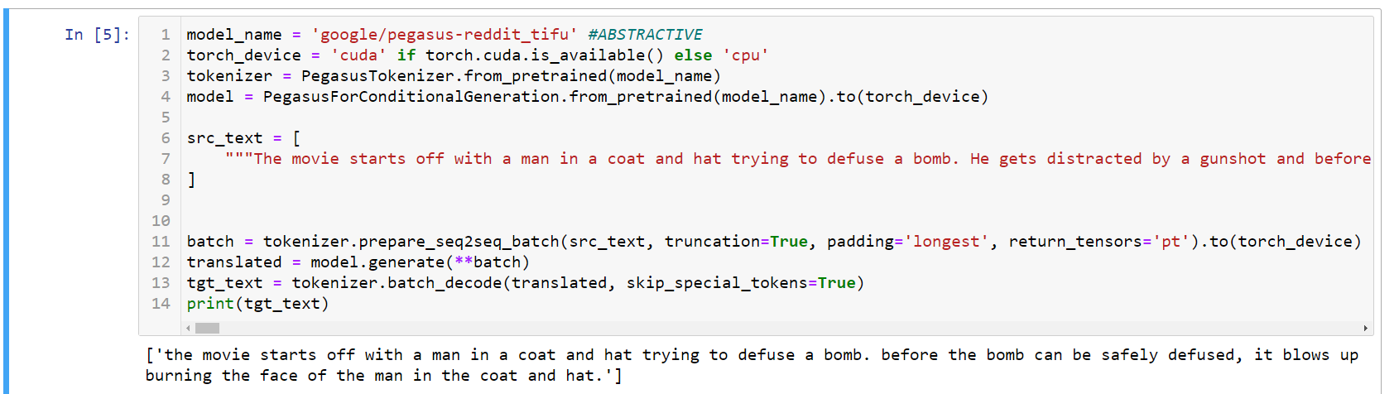
Pegasus (Reddit-tifu)_Abstractive
This model gives concise abstractive summary of the text passage.

Slide 22
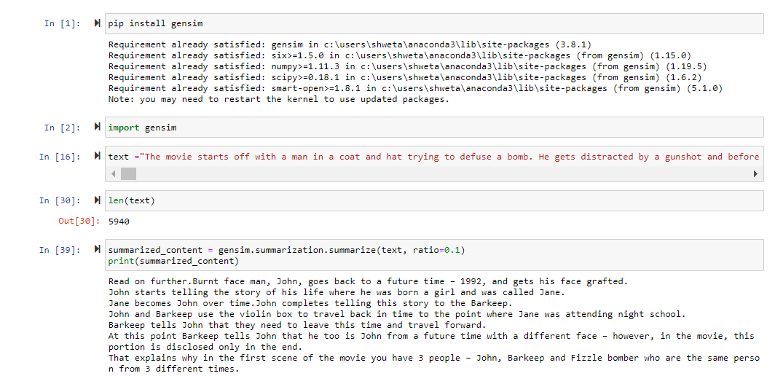
Gensim Approach - Extractive
Extracts one or more important sentences and also can extract on the basis of keywords.

Slide 23
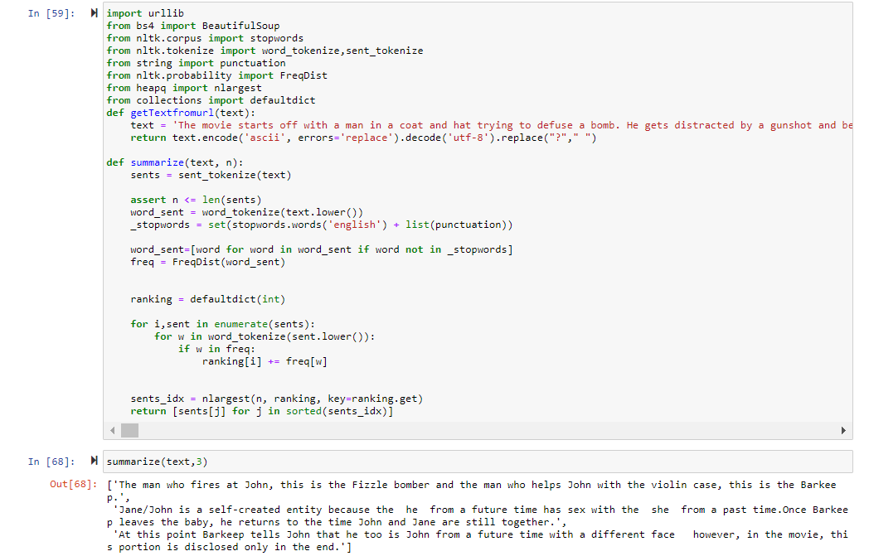
Rulebased Model

Slide 24
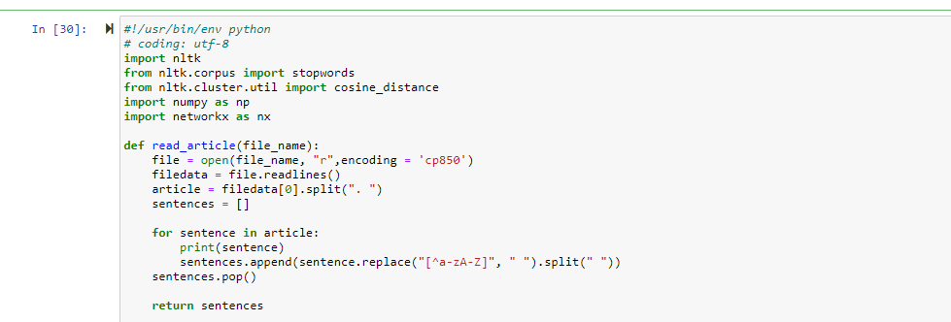
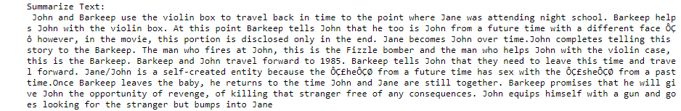
Textrank Model

Slide 25
Comparison of outputs
Standard input text length : 5940
Models | Method | Output(word count)
Pegasus (xsum) | Abstractive | 96
Pegasus(Large) | Extractive | 711
Pegasus(reddit-tifu) | Abstractive | 174
Gensim | Extractive | Ratio : 0.2=1545 0.3=2298
Rule Based | Extractive | Depends on sentences
Text Rank | Extractive | Input Top-3= 490

Slide 26
Pre-Processing
Stopwords Removal
Contraction mapping
Text Cleaning
Remove ‘s
Remove “”
Remove (Text-Between)
Tokenization
Sentence Tokenization
Word Tokenization

Slide 27
REFERENCES
J.N.Madhuri,Ganesh Kumar.R “Extractive Text Summarization Using Sentence Ranking,”Institute of Electrical and Electronics Engineers (IEEE),2019.
Siya Sadashiv Naik, Manisha Naik Gaonkar,” Extractive Text Summarization by Feature based sentence extraction using rule based,”IEEE International Conference On Recent Trends in Electronics Information & Communication Technology (RTEICT),2017.
Aakanksha Sharaff, Amit Siddharth Khaire, Dimple Sharma,”Analyzing fuzzy based approach for extractive text summarization,”International Conference on Intelligent Computing and Control Systems (ICICCS 2019).
Kaiz Merchant, Yash Pande ,” NLP Based Latent Semantic Analysis for Legal Text Summarization,”IEEE,2018.
Abu Kaisar Mohammad Masum, Sheikh Abujar, Md Ashraful Islam Talukder, AKM Shahariar Azad Rabby, Syed Akhter Hossain,” Abstractive method of text summarization with sequence to sequence RNNs”,ICCCNT,2019.
16

Slide 28
Thank You

